Slide 1
Google Analytics

Slide 2
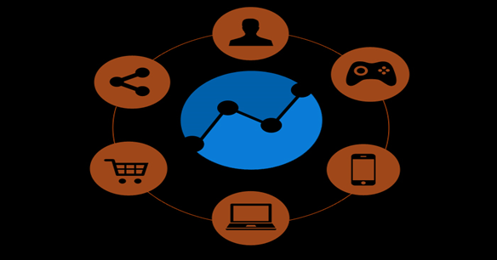
What is Google Analytics
Google analytics helps to measure the website traffic and gather vital information about website visitors. This tool can give the answers to all of the aforementioned questions and, thus, enable to see how website is actually performing.
Basically it provides the measurement, collection, analysis and reporting of internet data for purposes of understanding and optimizing web usage.
Google Analytics gives a clear picture of what changes need to implement to improve sites and maximize conversions.

Slide 3
Types of Analytics
Off-site Web analytics measure a web site's potential audience, visibility and buzz around the Internet in general. Off-site analytics can be utilized whether you have your own web site or not
On-site Web analytics measures a visitor's usage behavior as they view your web site
Use of Analytics
Measure for success
Pick something to measure success on
Design and layout
Content
SEO
Internet Marketing
Bandwidth
Understand what we are measuring
Decide what data we will be looking at
Make data driven decisions
What are you going to do with this now
What are you going to change

Slide 4
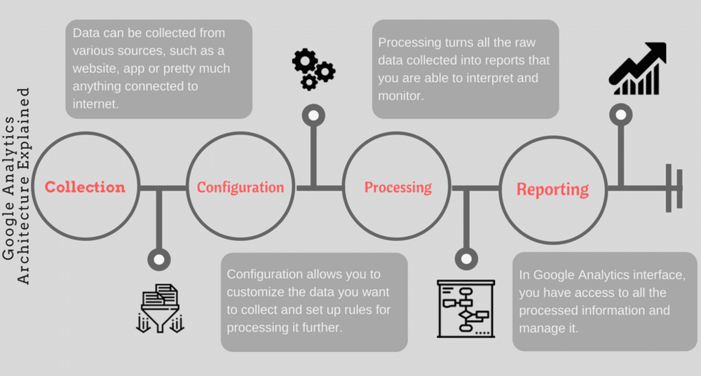
Analytics Architecture

Slide 5
Collection
User -> Session -> Hit
Whenever a user views a page - a new snapshot about what is happening is sent to GA server. The GA server combines this Hit data into sessions and these sessions are then tied on to particular user matching his client ID saved in the browser cookie.
Then the analytics tracking code assigns a unique client ID. Unique client ID is like DNA in Analytics worlds. Hence, two users can never have a similar unique ID. So, the next time the visitor lands on your site will be tracked as returning visitor based on the information saved in the cookie.
It also combines data from other sources such as IP address, Server log files, and ad-serving data. From these additional sources, GA gets additional information about the user for example location, browser, operating system, age, gender, about the referral
Configuration
Configuration can be thought of as the setting we apply to customize the data being collected. It’s about setting up the rules for data processing, which includes configuring Google Analytics features like setting up goals, applying filters, and creating custom dimensions/metrics.
We can also unlock hidden power features at the property level like demographics and interest reports, in-page analytics or enhanced link attribution. These all features help to define data in analytics and enables to analyse data more critically.

Slide 6
Processing
Once a hit is sent to Google Analytics carrying the interaction information, it processes that data. It is important to understand how data gets processed in order to make more informed decisions about data collection.
Google analytics processes collected data in the following three steps.
New Vs Returning Users
Sessions
Other data sources
Identifies New Vs Returning User
Google Analytics does is to identify the user type - new vs returning. It does this with the help of information stored in the browser cookies.
Reporting
Reporting provides access to all the processed data in the form of infographics through web interface, and also allows to get the processed data through reporting API.
However, GA allows great flexibility to create custom reports apart from these default reports can also create our own custom reports in order to analyse two different dimensions and metrics together.
In web interface, we can look into reports of various types including: Real time, Acquisition, Audience, behaviour and Conversions.

Slide 7
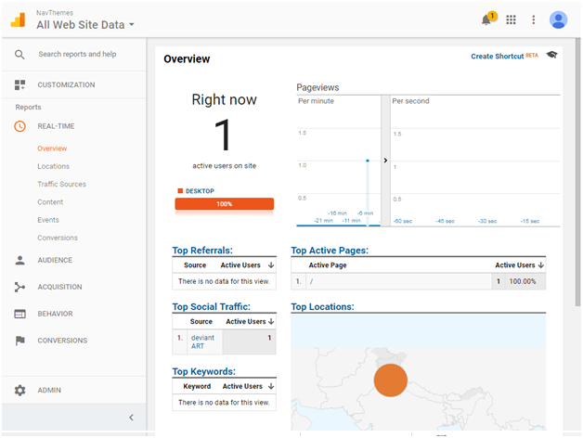
Real Time:
While clicking on Overview, it shows at the moment how many visitors are active on website. If there are Active Users on website, then it displays the information about the page which that person is viewing.
If we click on the Location, it tells us from where the user is accessing our website and also tells page views per minute.
If we click on Traffic Sources, it tells us the person who is viewing our web page came from organic search, referral website, social website etc.
Other features such as Content, Event and Conversions provides nearby accuracy in real time for showing who is on web site.

Slide 8
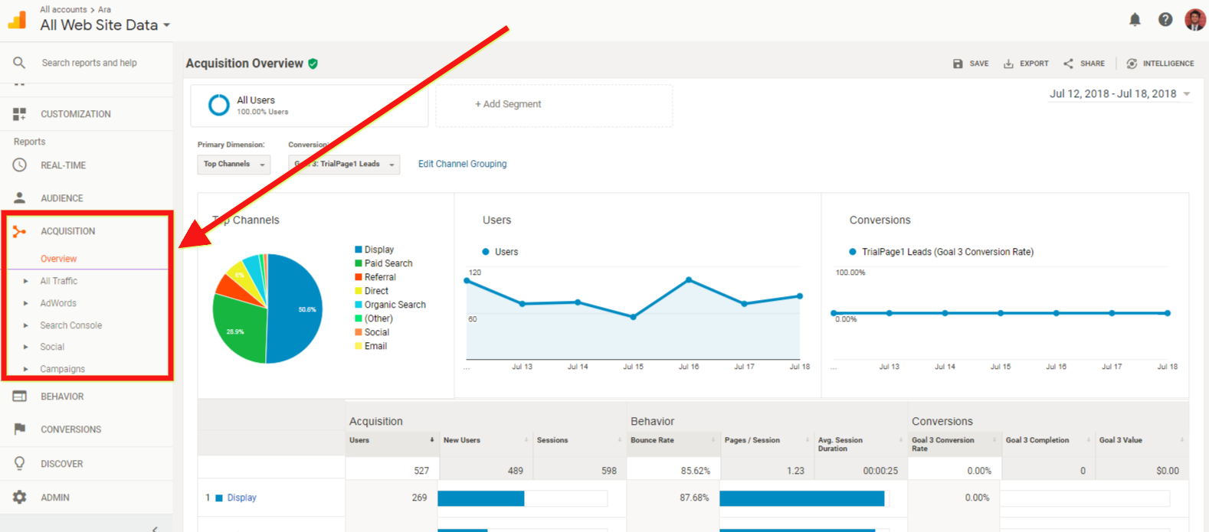
Acquisition:
It tells, where visitors came from and how we acquired them. So, it tells us how many of them came from Google through organic search, how many directly punched into the URL into the address bar, how many came through referral, social and other sources.
For more information, if we click on All Traffic it will tell us the name and URL’s of the places where the traffic is coming from.
Campaigns
Campaigns mainly gives information on how well campaigns are working. It depend which campaign we are
running either it’s Google Ad Words, Email or something else.

Slide 9
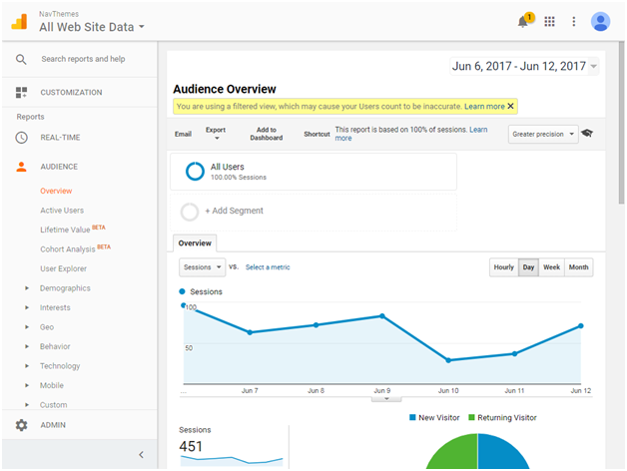
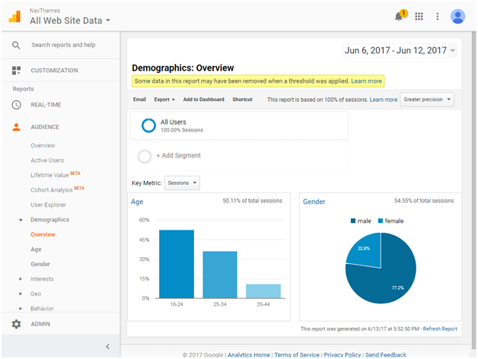
Audience:
When click on Overview, it shows us the same graph about data. We can change the date range as well.
Active users, it shows the active users on website.
Audience also indulges the Lifetime Value Report which shows how users get valued and engaged including Page Views, Sessions and Goals.
Cohort Analysis, which is a subset of behavioural analytics that takes the data from a given dataset and it doesn’t look at all users as one unit, it breaks them into related groups for analysis.
Apart from these, we can view reports based on Demographic, Interest, Geo, Behaviour, Technology, Mobile and Users Flow here.

Slide 10
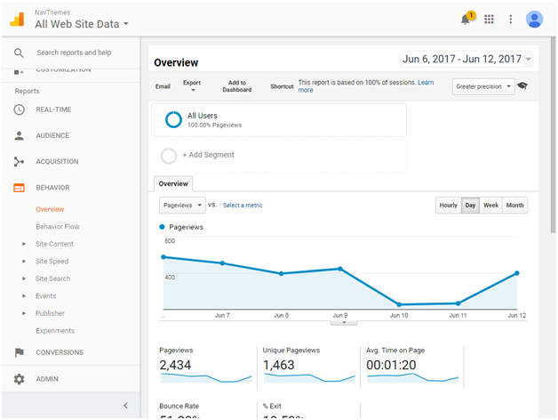
Behavior:
If we click on Behavior’s flow, it gives another one of those flow charts showing the path that visitors take and it is based on landing pages.
It tell about the Site content, Site speed and Site search.
Conversion:
It will tell the goals, and detailed description of product and sales performance. It evaluates the effectiveness of the channel.

Slide 11
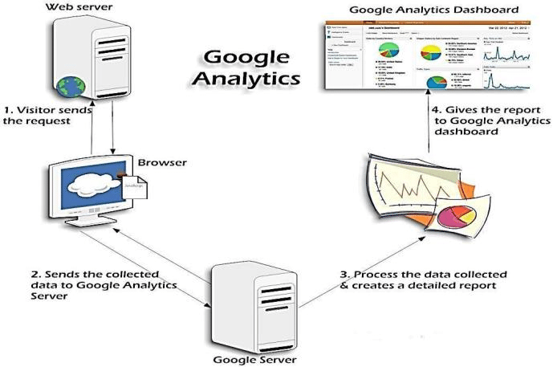
Reporting views:
Intelligence Reporting
Daily alerts
Weekly alerts
Monthly alerts
Visitors Reporting
Map
New vs Returning
Visitor Loyalty
Browsers
Traffic Sources Reporting
Direct Traffic
Referring Sites
Search Engines
Keywords
Content Reporting
Top Content
Top Landing Pages
Top Exiting Pages

Slide 12
THANK YOU

